Slide 1
JNCIS-ENT
Border Gateway Protocol (BGP)

Slide 2
BGP Path Selection
4
BGP route attributes

Slide 3
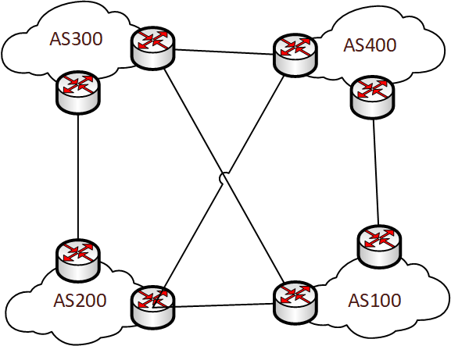
A Path Vector Protocol
BGP is sometimes called a “path vector protocol” because it uses path attributes for best path selection, rather than a bandwidth-based metric
BGP route attributes are split into multiple categories regarding their transmission between AS’s and their requirement to be included
Transitive / non-transitive
Transitive route attributes are transmitted across AS boundaries
Mandatory / Discretionary
Mandatory attributes are required to be included will all route advertisements
Well-known / Optional
Well-known attributes should be understood by all BGP speakers
Optional attributes might not be understood by all BGP speakers, depending on the vendor’s implementation of BGP

Slide 4
Route Attributes
Described in RFC 1771
Name | Type | Description
Local Preference | Well-known discretionary | Locally significant preference for routing information to use
Originator ID* | Optional non-transitive | The Router ID which originated the route advertisement
AS Path | Well-known mandatory | An ordered list of AS’s which the advertisement has passed through
Origin Code | Well-known mandatory | Specifies if the route was learned by IGP, EGP or incomplete
MED | Optional non-transitive | A preference value for influencing inbound traffic from another AS to which multiple exits exist
Next-hop | Well-known mandatory | Specifies the next-hop IP address to use or resolve for this route
Community** | Optional transitive | A list of arbitrary values to be used for logic against the route
Aggregator | Optional transitive | Used by BGP speakers which perform route aggregation
Atomic Aggregate | Well-known discretionary | Used to inform other BGP speakers that a more specific route included in the route was not chosen
Cluster List* | Optional transitive | Used for loop prevention and includes the cluster ID for a route reflector cluster
Notes:
We’ll discuss the common BGP attributes in more detail, next-hop, local pref, as path, origin, MED and community
*Defined in RFC4456 for BGP route reflection
**Introduced in RFC1996 with many revisions to add additional communities

Slide 5
Next Hop Attribute
Used to advertise the next-hop of the advertising router
For the route to become active, the next-hop must be reachable
The next-hop attribute is not changed in iBGP peerings
The next-hop attribute is changed for eBGP peerings
The attribute is always present in route advertisement

Slide 6
Local Preference Attribute
Local preference is used to influence the preference of BGP routes
Local preference is advertised to iBGP peers but not eBGP peers
The attribute is typically used to influence preferred routes to a destination, like a preferred ISP provider
A higher local preference is more preferred
Default is 100

Slide 7
AS Path Attribute
AS Path is a list of autonomous systems that the route advertisement has passed through
When a route is advertised to an EBGP peer, the local AS is added to the AS path
If the local AS is seen on an incoming route advertisement’s AS Path attribute, the route is dropped to avoid a routing loop

Slide 8
MED Attribute
The multi-exit discriminator (MED) is used to advertised a preferred inbound path to the local AS when multiple exits to the remote AS exist
A lower MED value is more preferred

Slide 9
Origin and Community
The origin attribute indicates the source of the original route advertisement
Valid values are:
0 – IGP
1 – EGP
2 – Incomplete
The EGP value is not seen anymore due to EGP not being in active use anymore
Communities are used to tag routes with arbitrary values which can be used in route policies to perform any configurable actions against the tagged routes
Communities typically follow the format of AS:community
65003:101

Slide 10
BGP Best Path Selection
When multiple paths are known for a single destination, the below order of operations is taken to determine which path to use.
If there is a tie, or the attribute is not present then the next check in the order is done until the tie is broken
Evaluation Order | Route Attribute Evaluated | Winning Criteria
1 | Local Preference | Highest local preference
2 | AS Path | Shortest AS Path
3 | Origin | Lowest Origin Code
4 | MED | Lowest MED
5 | EBGP/IBGP Peer | EBGP over IBGP
6 | IGP Metric | Lowest IGP Metric
7 | Active Route | The currently active route is preferred
8 | Cluster Length | Shorter cluster length
9 | Peer Router ID | Lowest peer RID

